Slide 1
PREDICTION OF LOAN DEFAULTERS
Team Details
Batch details | PGPDSE-FT Offline Apr 22
Team members | Swarnashree Pratiksha Patil Taniya C Mathews R Praveen Nawaz S
Domain of Project | Finance and Risk Analytics
Proposed project title | Detection of Loan Defaulters
Group Number | 6
Team Leader | Swarnashree
Mentor Name | Ms Vidhya K

Slide 2
Problem Definition
The Bank Indessa has not done well in last 3 quarters. Their NPAs (Non Performing Assets) have reached all time high and it is starting to lose confidence of its investors. As a result, it’s stock has fallen by 20% in the previous quarter alone. After careful analysis, it was found that the majority of NPA was contributed by loan defaulters. With the data collected over all the years, we have to build a model which will help us predict the defaulters accurately to reduce the loss of credit to the bank.
Technologies used
According to our dataset we need Classification Machine learning algorithms for detecting the defaulters such as Logistic Regression, Random Forest, Naïve Bayes , Decision Tree, K-Nearest Neighbours.
Also we make use of visualisation libraries like seaborn & matplotlib.
For EDA and Statistics work we make use of scientific python library, sklearn library etc.

Slide 3
Why it is important problem
According to RBI, Banks have written off 2.02 lakh crore rupees in FY21 and With this, banks have written off a whopping Rs 11,68,095 crore worth of bad loans or non-performing assets (NPAs), in the last ten years. So it is very important for the bank to be skeptical about issuing loan.
Banks face two types of risks while they decide to lend the loans:
If the applicant is likely to repay the loan, then not approving the loan results in a loss of business to the company.
If the applicant is likely to default the loan, then approving the loan may lead to a financial loss for the company.
Thus banks emphasize on coming up with Machine Learning models which will help them with this problem.
We in this project have tried to analyze the behavior of the defaulters in the past using various EDA, statistics and visualization techniques and come up with a machine learning model which will help us predict the defaulters with high accuracy.

Slide 4
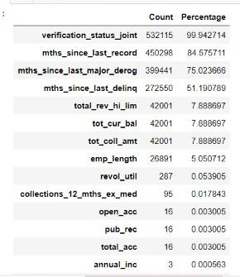
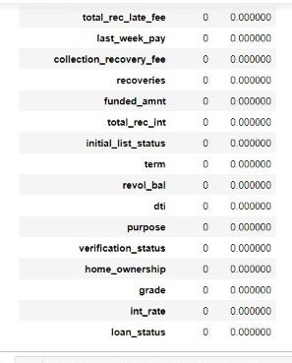
Data Cleaning and Understanding
The dataset has 5,32,428 records and 45 attributes.
It features are of int, float and object datatype.
It has 0 duplicated data points.
After analyzing the nature of the column, null values were imputed accordingly.

Slide 5
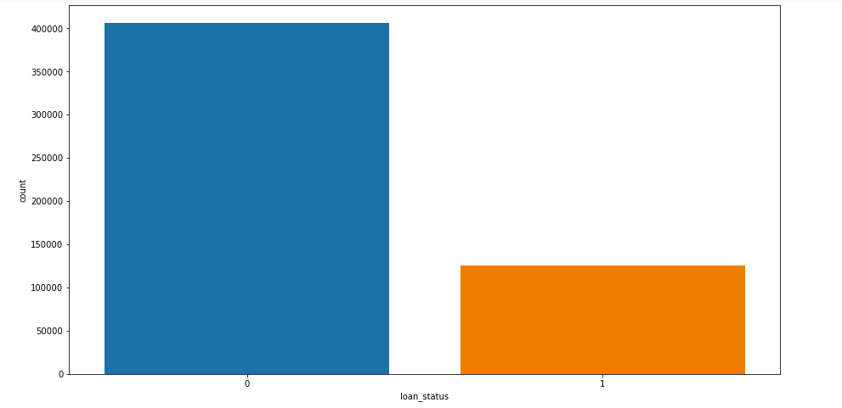
Distribution of Target Variable
From the plot we can infer that our data set is highly imbalanced.
The count of Non Defaulters is almost three times that of Defaulters.
Since there is a problem of class imbalance, SMOTE is to be used to overcome it.

Slide 6
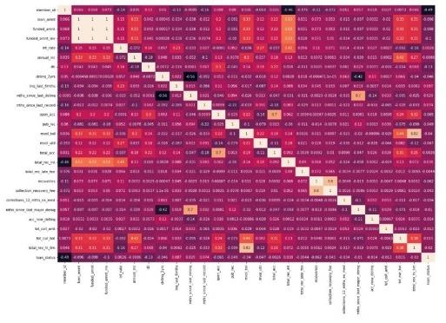
Heatmap of Numeric features
‘Loan_amt’,’funded_amt’,’funded_amt_inv’ all three features have correlation close to 1.
‘Collection_recovery_fee’,’recoverie’ has a correlation of almost 1.
‘Total_rev_hi_lim’,’revolving_bal’ have a correlation of 0.8
‘Member_id’,’delinq_2_yrs’,’delinq_last_6_mths’, features have very low correlation with all other features.
‘Mnths_since_last_major_derog’,’mnths_since_last_delinq’ have a correlation of 0.7.

Slide 7
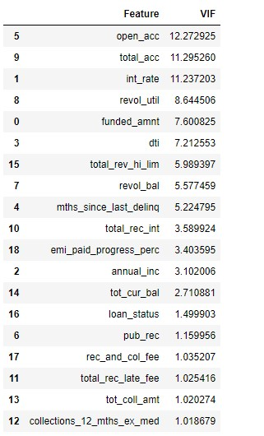
VIF
VIF is not very high for any features, so we decided to use all the features to build our basic model and we shall build the upcoming models based on the p_value of each feature we'll decide it's significance for our prediction.
If we find it insignificant, we’ll drop it.

Slide 8
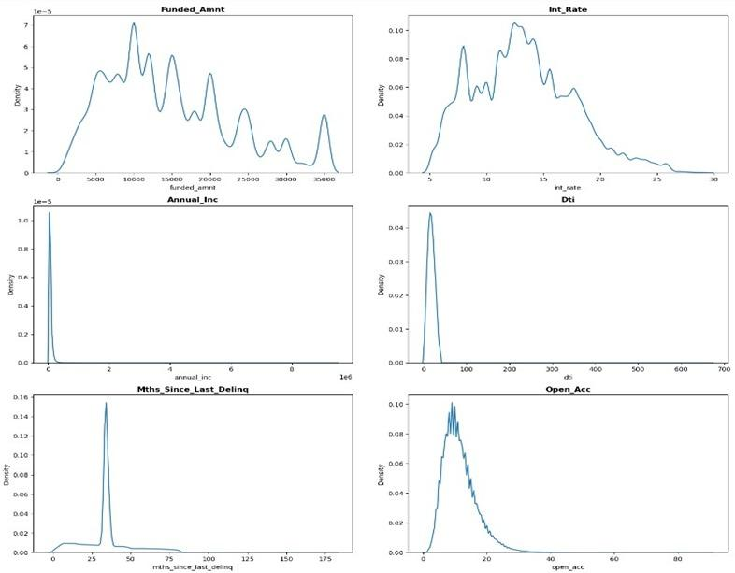
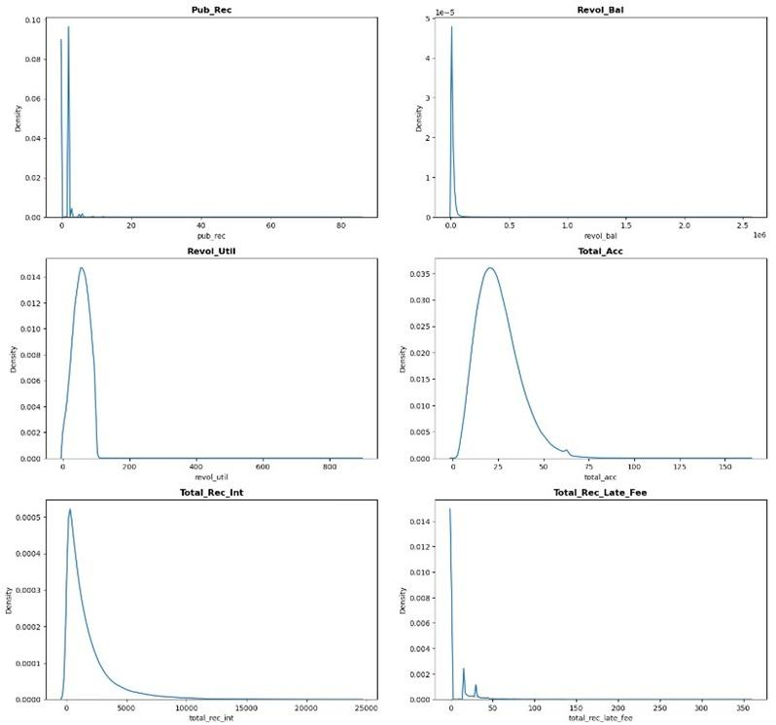
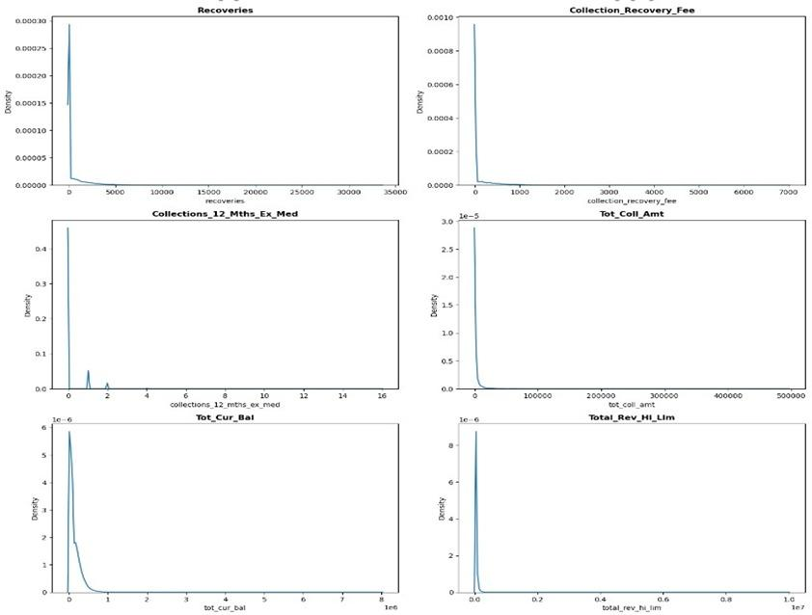
Analysis of Numeric Features
All of the numerical features are highly right skewed.
None of them have Negative Values
Some features consists 85% of their values as 0s

Slide 9
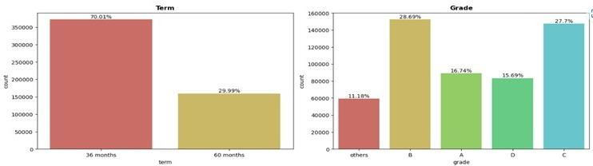
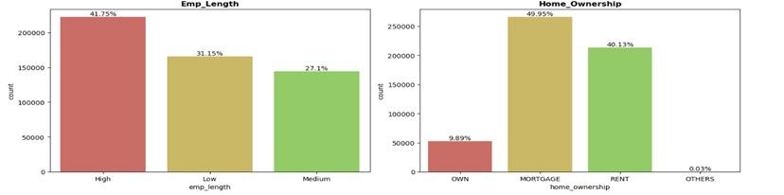
Analysis of Categorical Features.

Slide 10
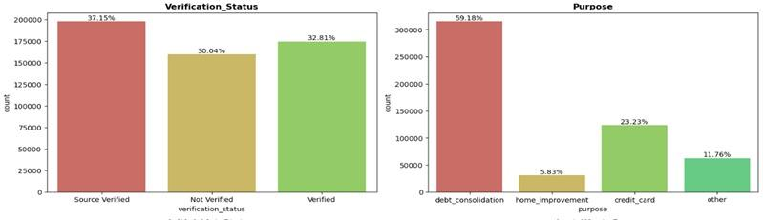
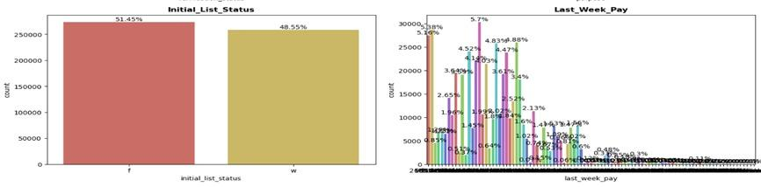

Slide 11
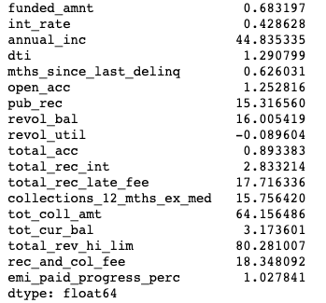
Defaulters have more debt to pay back.
People who have defaulted have more public records.
The interest rate of defaulters is also more than that of defaulters.
On an average the dti of defaulters is lesser than that of non-defaulters.
100 % Non-defaulters have payed back after being charged-off and none of defaulters have payed back after being charged-off.
The total collection amount of defaulters is less than that of non-defaulters.
Skewness

Slide 12
Outlier Analysis
Several features consists of huge outliers which have created right skewness but we can’t remove outliers as it will lead to loss of important information which will further lead to incorrect classification.
Transformation
We did not apply transformation on our data because,
Scaling
We employed standard scalar and performed Z-Score scaling.
Encoding
We used one hot encoding to all encode all categorical features as there was no order.

Slide 13
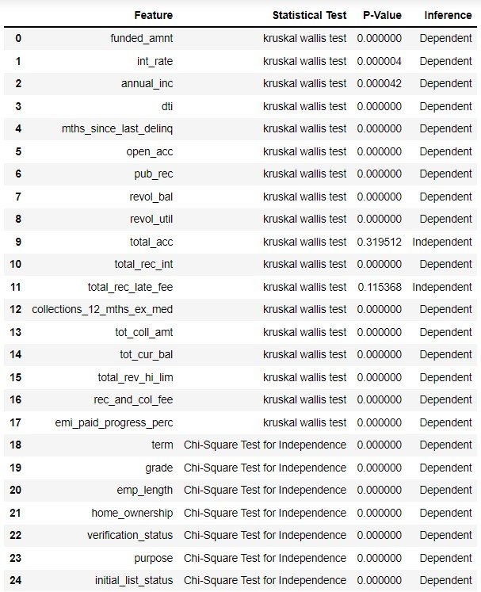
STATISTICAL SIGNIFICANCE

Slide 14
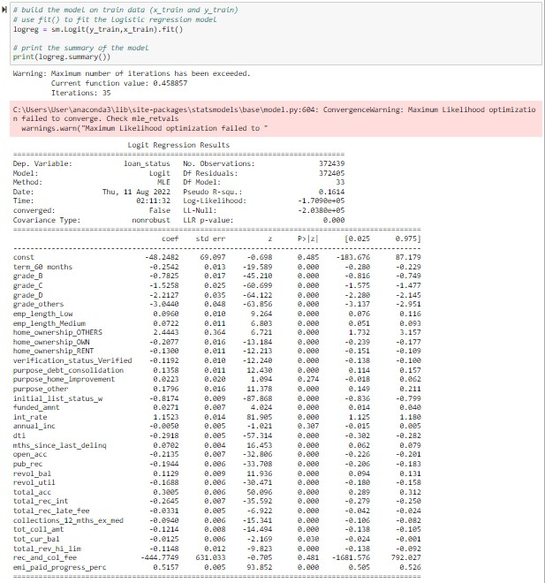
BASE MODEL
BUILD A FULL LOGISTIC MODEL ON A TRAINING DATASET
LLR p-value of the model is 0.000, which is less than 0.05 therefore Null hypothesis is rejected and thus, there is at least one feature which is significant.
Pseudo R-square of the model is: 0.1614, it’s far from 1 therefore we conclude that there are many improvements to be done on the model.
Log-Likelihood of the model is: -1.7090e+05 which is greater than the Log-Likelihood of the Null Model i.e., -2.0380e+05.
'purpose_home_improvement’, annual_inc','rec_and_col_fee' are insignificant features.

Slide 15
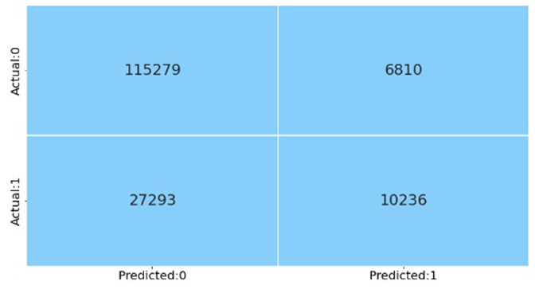
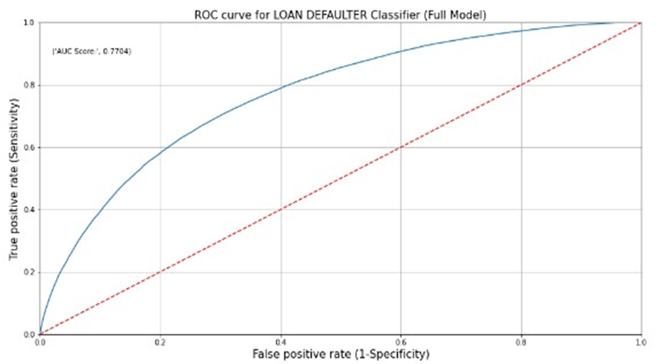
CONFUSION MATRIX
ROC - AUC CURVE

Slide 16
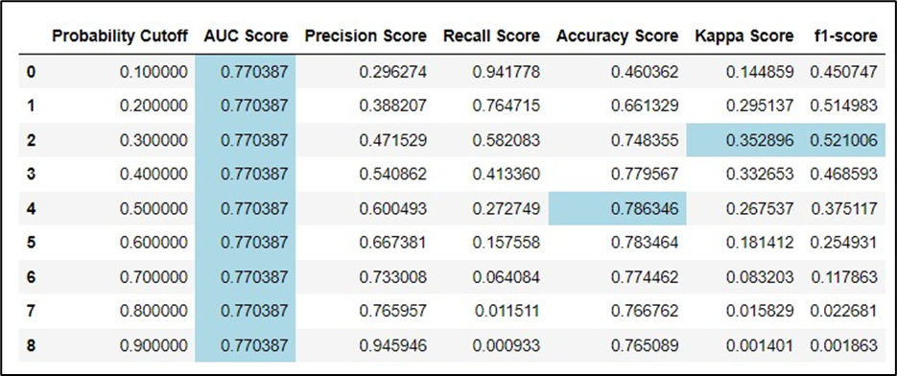
SCORE CARD FOR LOGISTIC REGRESSION
The Logistic Regression model we’ve built will help the bank to predict the defaulters on the basis of their details with an accuracy of 78%.

Slide 17
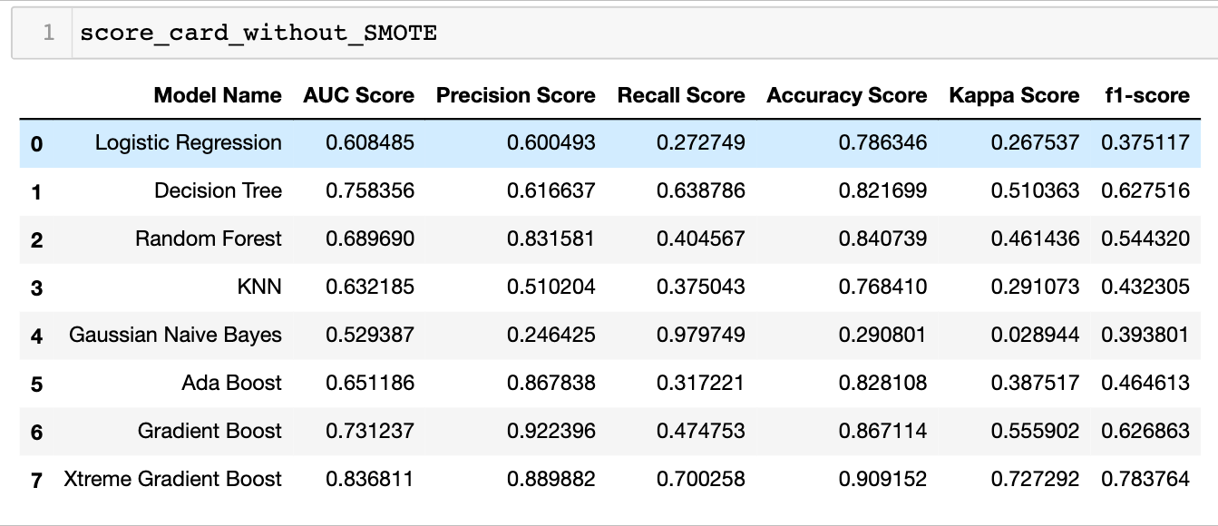
CLASS IMBALANCE TREATMENT
We used SMOTE to overcome the class imbalance problem.
SCORE CARD OF VARIOUS MODELS BEFORE SMOTE :

Slide 18
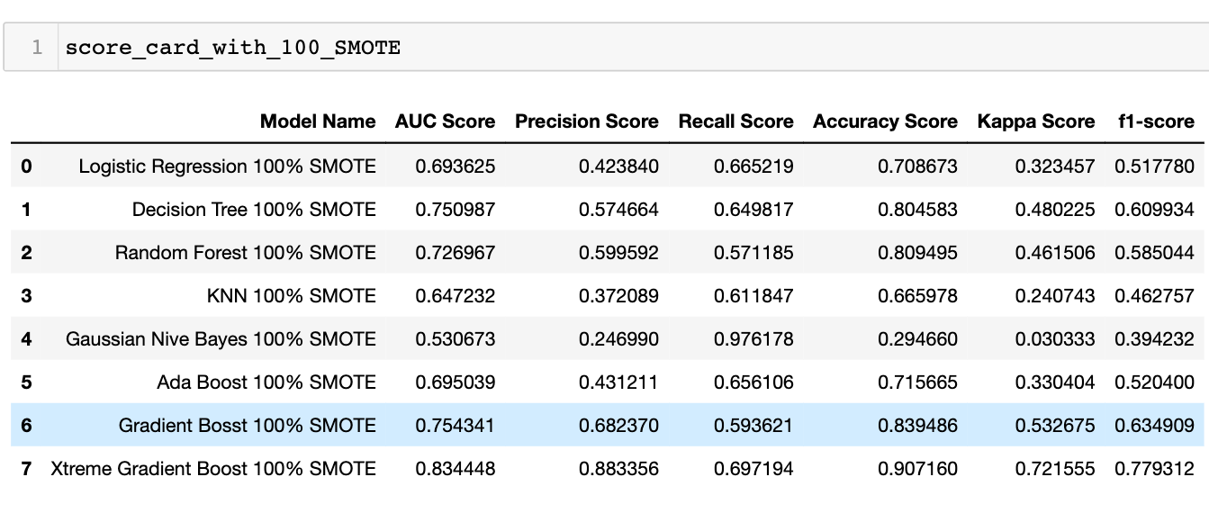
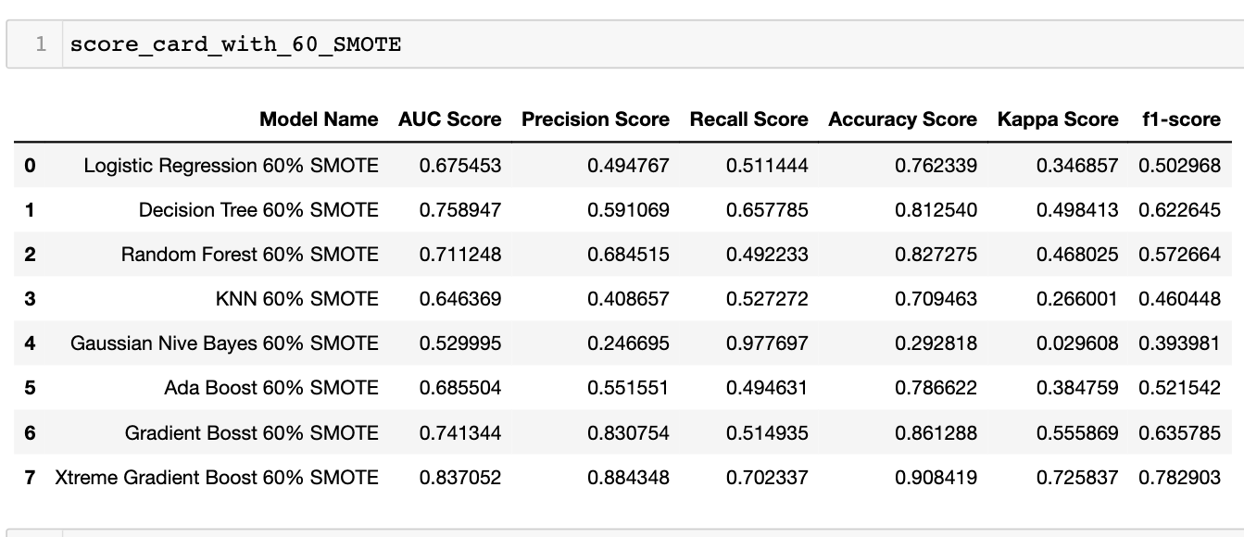
SCORE CARD OF VARIOUS MODELS AFTER SMOTE :
SAMPLING STRATEGY 100%
SAMPLING STRATEGY 60%

Slide 19
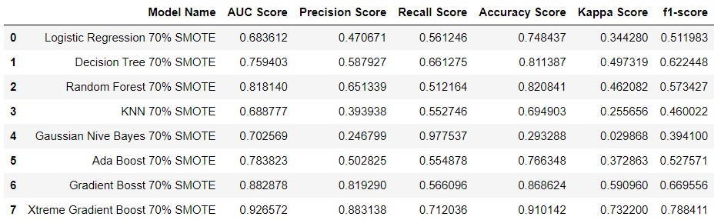
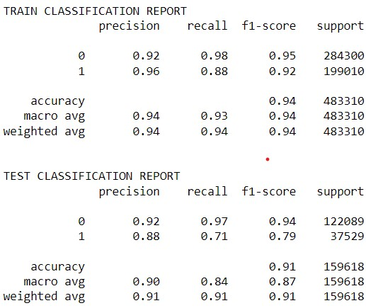
SAMPLING STRATEGY 70% :
CLASSIFICATION REPORT OF XGBoost MODEL AFTER USING 70% SMOTE :
Train Accuracy : 0.94
Test Accuracy : 0.91

Slide 20
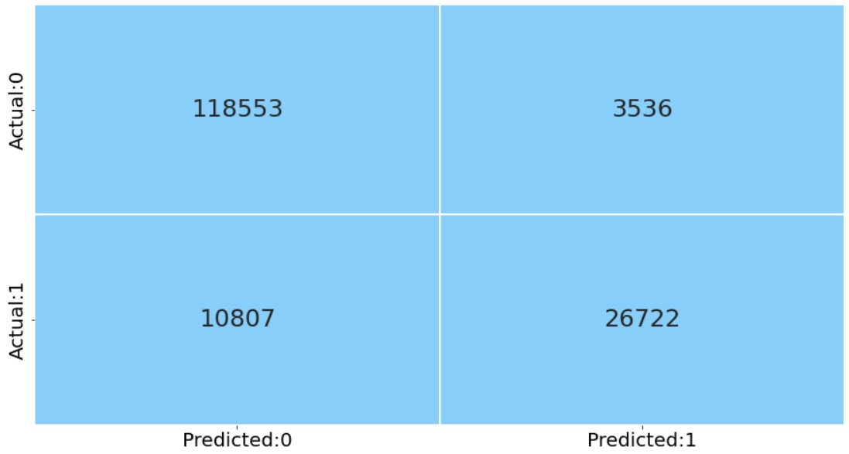
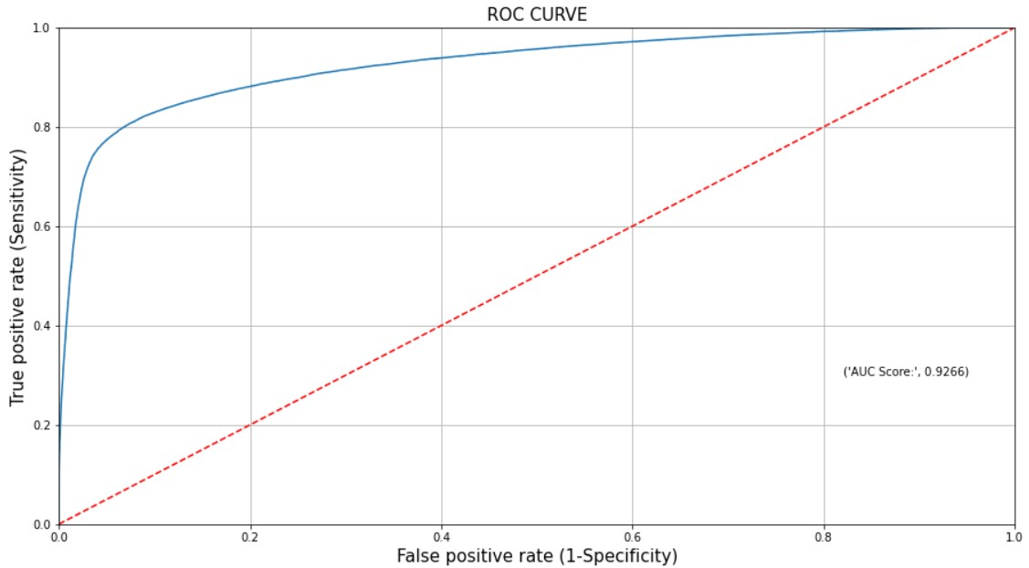
CONFUSION MATRIX USING 70% SMOTE :
ROC CURVE USING 70% SMOTE :

Slide 21
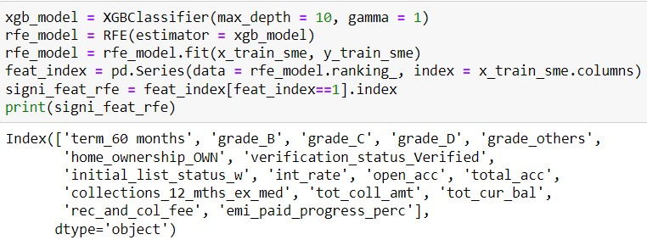
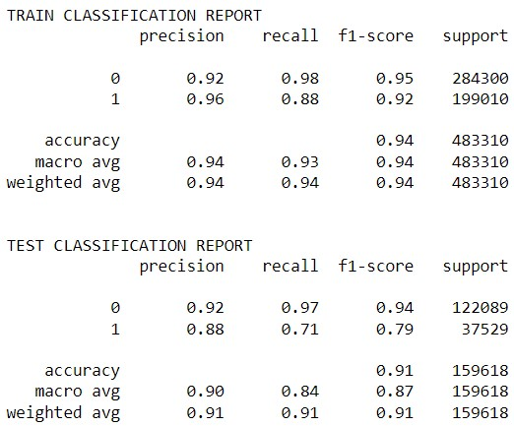

FEATURE SELECTION USING RFE
XTREME GRADIENT MODEL BUILT USING SIGNIFICANT FEATURES FROM RFE
CLASSIFICATION REPORT
CONFUSION MATRIX

Slide 22
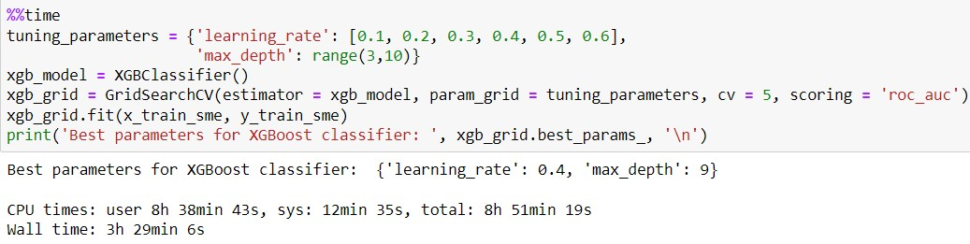
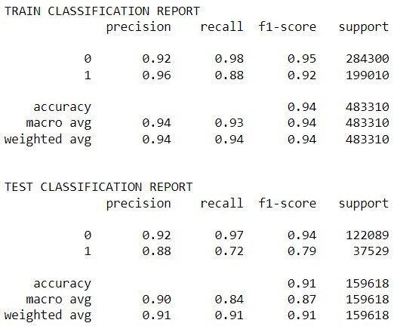
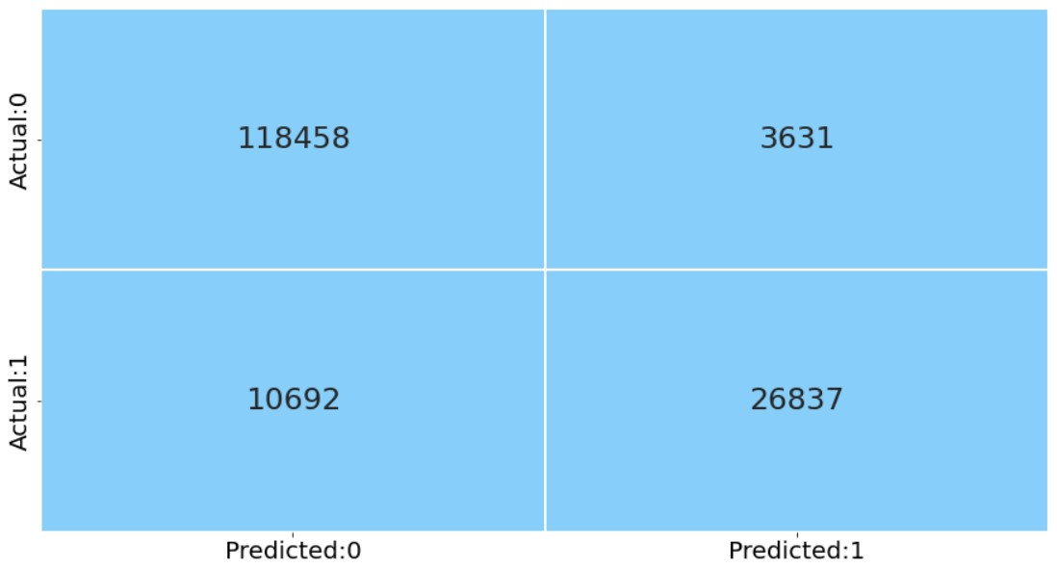
HYPER PARAMETER TUNING USING GRID SEARCH
XGB MODEL BUILT USING THE BEST PARAMETERS FROM GD
CLASSIFICATION REPORT
CONFUSION MATRIX

Slide 23

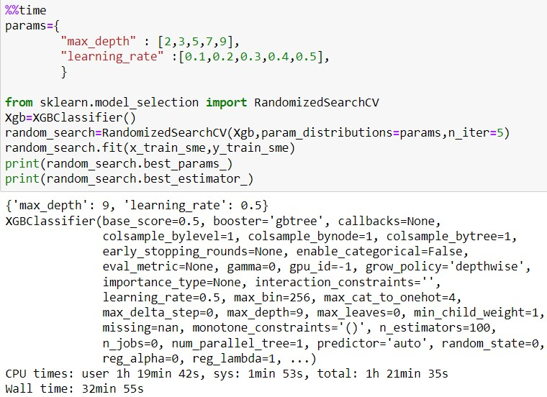
ROC CURVE XGB MODEL BUILT USING
THE BEST PARAMETERS FROM GD
HYPER PARAMETER TUNING
USING RANDOM SEARCH

Slide 24
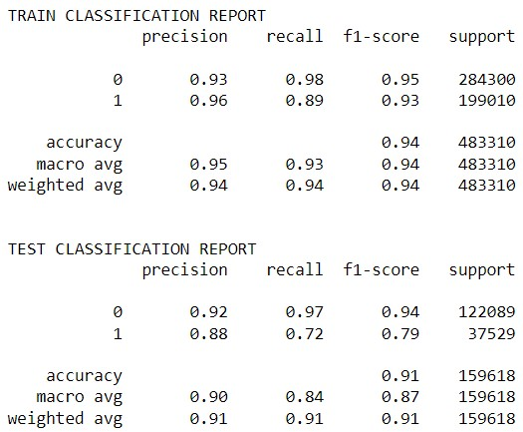
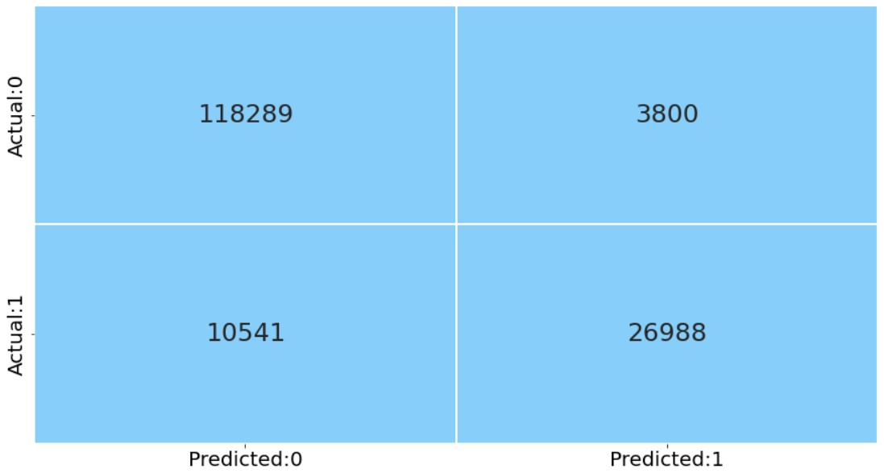

XGB MODEL BUILT USING THE BEST PARAMETERS FROM RS

Slide 25
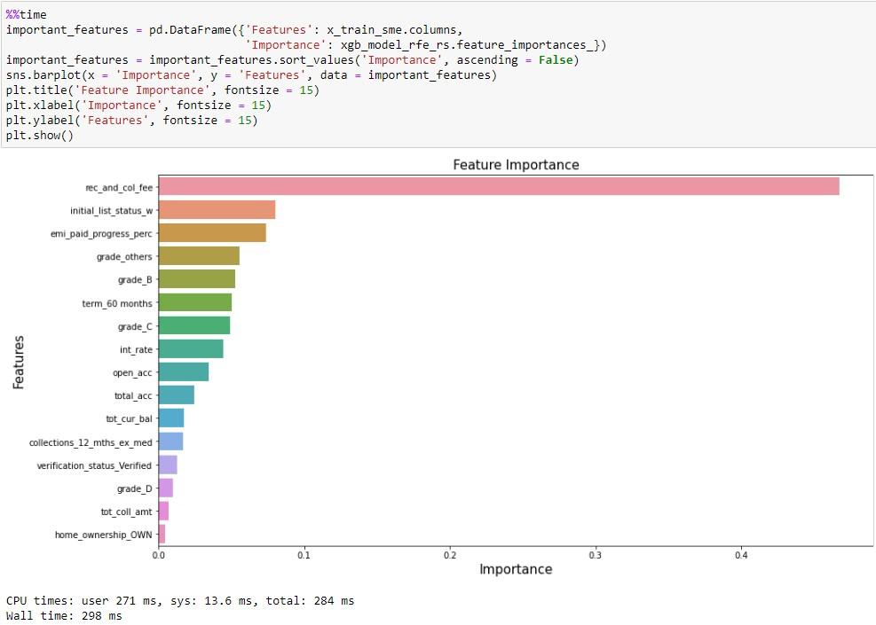
FEATURE IMPORTANCE

Slide 26
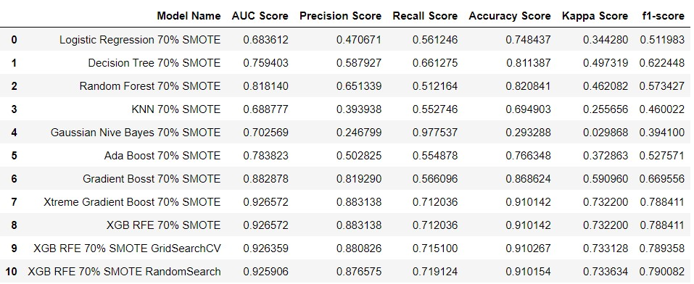
CONCLUSIONS
FINAL SCORE CARD
In this project we made 10 algorithms. We started with the base model and took the inferences from them after evaluating important measures we went for their parameter tuning to increase their performance.
Based on our objective, we had to focus on reducing the False Negatives i.e., the Type 2 Error, because predicting those who are actually defaulters as non-defaulters who cause the bank a major loss.
Since, our data is highly imbalanced we mainly focus on the F1-Score, because the performance metrics ‘accuracy’ would be affected due to bias.
As we can see we are getting best recall score and F1-Score in XGBoost model built with the significant features from RFE and tuned by Random Search with 70% SMOTE.
Based on the Feature Importance derived based on XGBoost Random Search 70% SMORE, we observe that the feature ‘rec_and_col_fee’ has the highest importance and this was one of the new features we brought into the model.
The major Limitation of the model we have built is the high imbalance in data and even after handing the imbalance using SMOTE, we are trying to introduce BIAS in the model.

Slide 27
Thank You!

